Slide 1
Hybrid Approach for Control and Fault Detection for Large Scale systems
Problem Definition
Common Approaches & Challenges
Proposed Approach
Chemical processes must ensure product quality, plant safety, and economic efficiency.
However, they are prone to faults, which can lead to asset damage, unsafe operation, or plant shutdowns.
A robust controller is essential to handle disturbances and maintain system stability, before things go wrong.
Approach | Strengths | Limitations
PID Control | Simple, widely used in industry | Poor for MIMO/nonlinear systems
Linear MPC | Fast, convex optimization | Breaks under nonlinear dynamics, unmeasured disturbances, or faults
Nonlinear MPC | Handles nonlinearities | Computationally intensive, convergence issues
Fault Detection | Can detect after it happens | But not early enough to make proactive control decisions
Safe RL Implementation:
  RL learns from MPC-generated actions → safe and guided exploration.
  Reduces the risk of unsafe behavior in industrial deployment.
Hybrid Fault Detection, Using first-principles hydraulic models + data-driven:
  Estimate unmeasurable internal states
  Detect early signs of flooding
  Allow proactive control action before faults escalate
Amir Hossein Hamedi Supervisor: Dr. Mhaskar
MACC Annual Meeting 2025

Slide 2
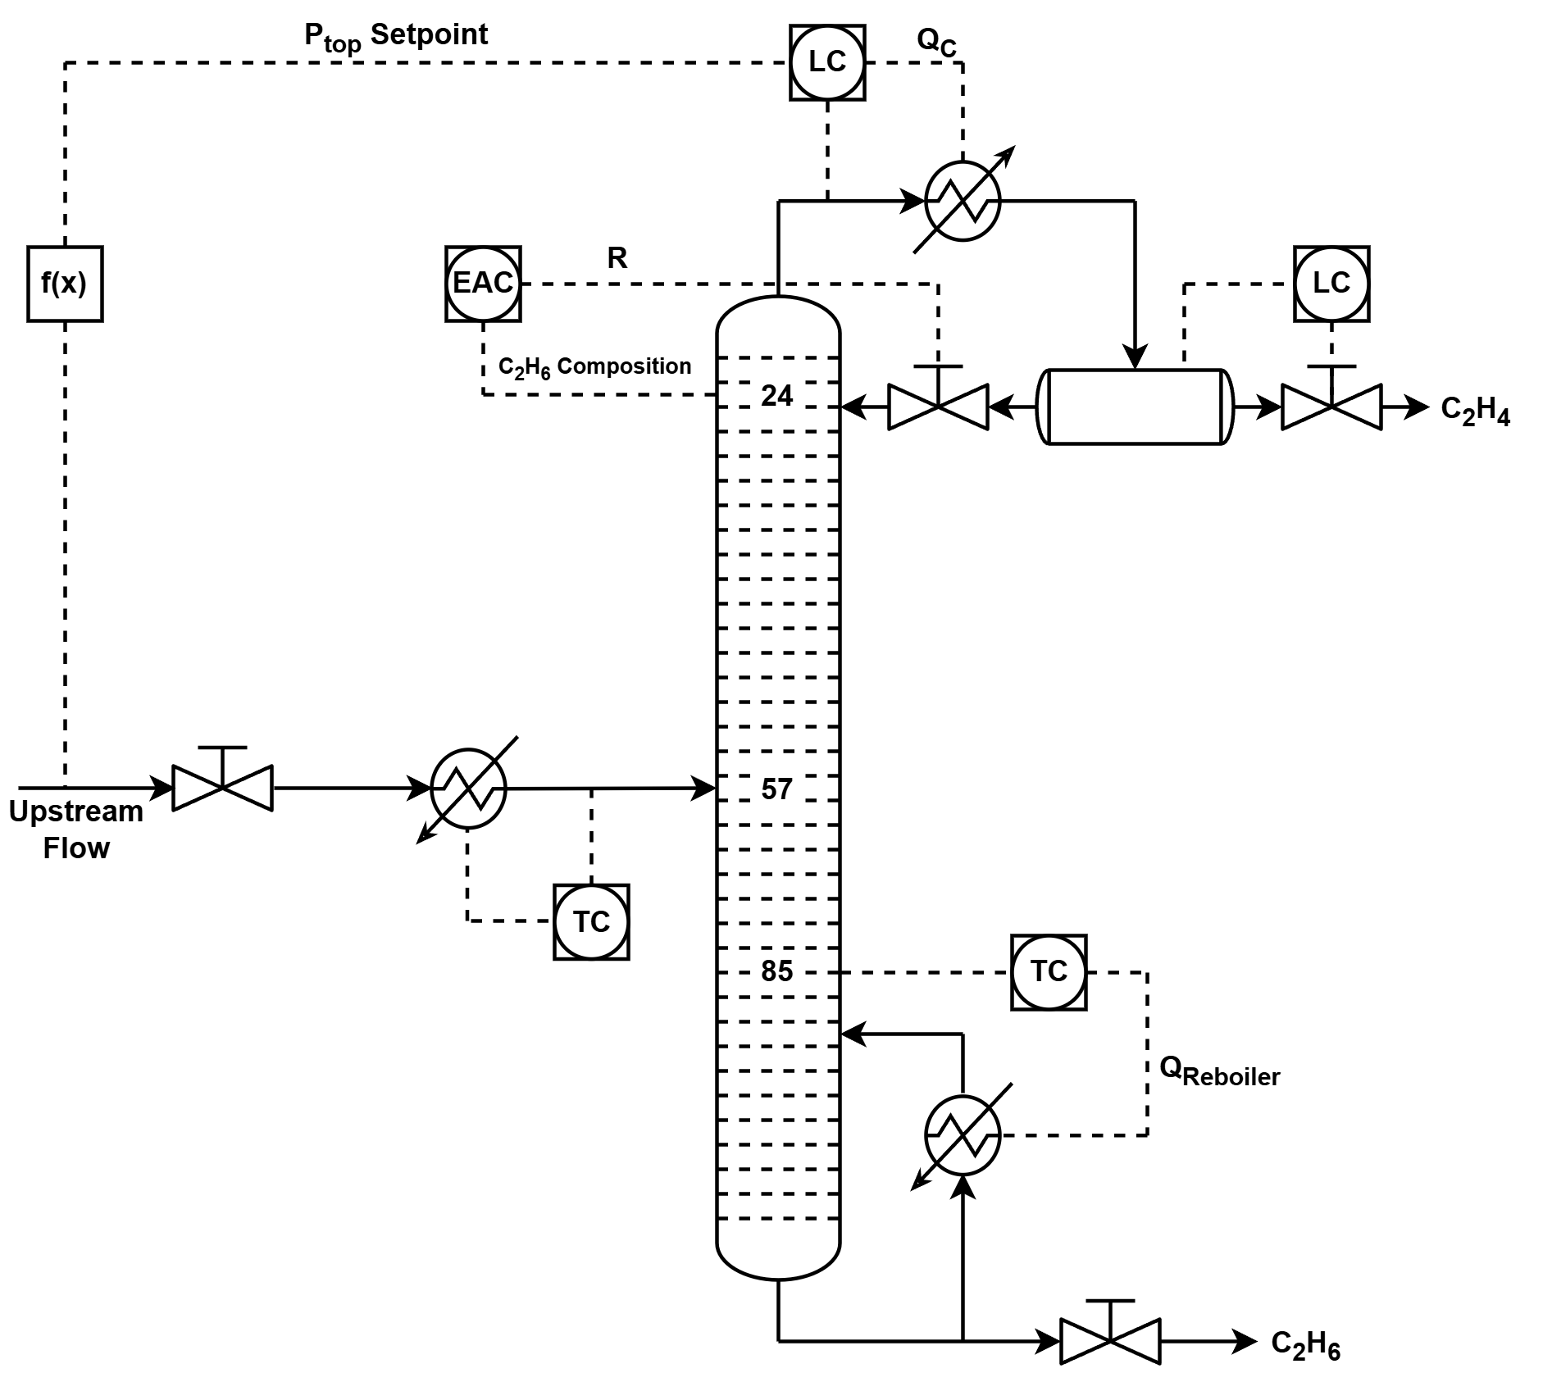
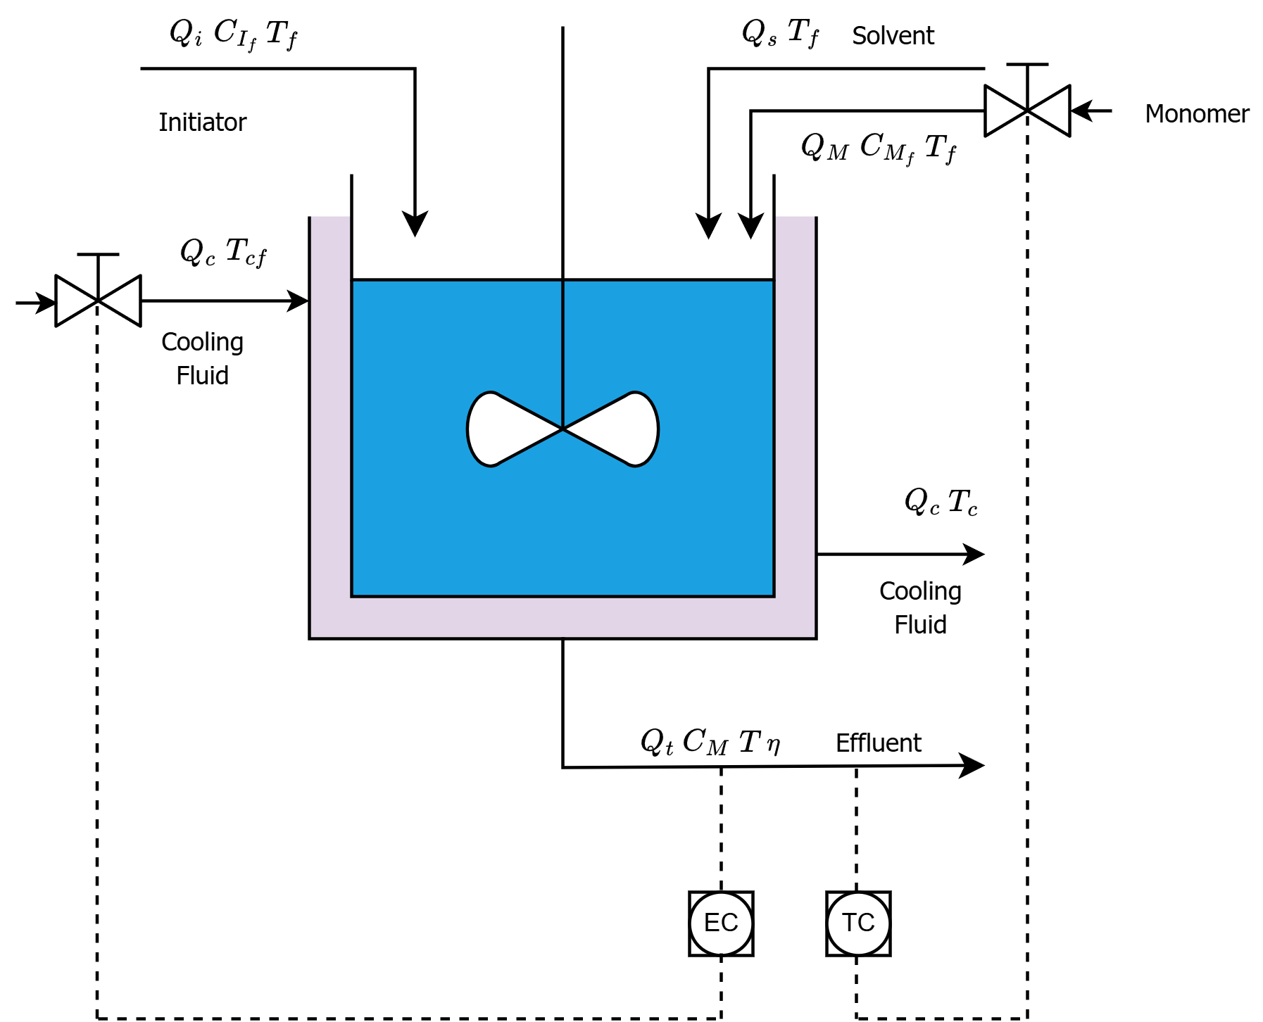
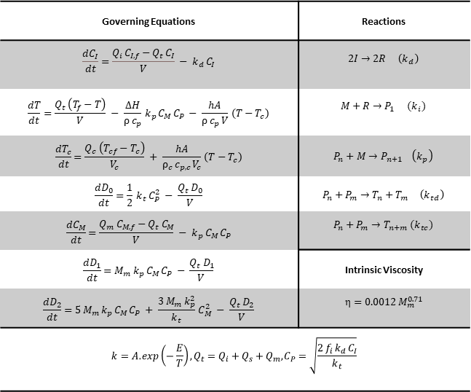
Case Studies
Ethylene Splitter (C₂S)
Continuous Styrene Polymerization Reactor
Manipulated inputs:
Reflux Flow
Reboiler Duty
Controlled Outputs:
Tray 24 ethane comp.
Tray 85 temp.
Manipulated inputs:
Cooling flow
Monomer Flow
Controlled Outputs:
Viscosity
Temperature
Governing Equations | Reactions
$$\frac{dC_{I}}{dt}=\frac{Q_{i} C_{I,f}−Q_{t} C_{I}}{V} − k_{d} C_{I}$$ | $$2I→2R \left(k_{d}\right)$$
$$\frac{dT}{dt}=\frac{Q_{t} \left(T_{f}−T\right)}{V} − \frac{ΔH}{ρ c_{p}} k_{p} C_{M} C_{P} − \frac{hA}{ρ c_{p} V} \left(T−T_{c}\right)$$ | $$M+R→P_{1} {(k}_{i})$$
$$\frac{dT_{c}}{dt}=\frac{Q_{c} \left(T_{cf}−T_{c}\right)}{V_{c}} + \frac{hA}{ρ_{c} c_{p,c} V_{c}} \left(T−T_{c}\right)$$ | $$P_{n}+M→P_{n+1} \left(k_{p}\right)$$
$$\frac{dD_{0}}{dt}=\frac{1}{2} k_{t} C_{P}^{2} − \frac{Q_{t} D_{0}}{V}$$ | $$P_{n}+P_{m}→T_{n}+T_{m} \left(k_{td}\right)$$
$$\frac{dC_{M}}{dt}=\frac{Q_{m} C_{M,f}−Q_{t} C_{M}}{V} − k_{p} C_{M} C_{P}$$ | $$P_{n}+P_{m}→T_{n+m} (k_{tc})$$
$$\frac{dD_{1}}{dt}=M_{m} k_{p} C_{M} C_{P} − \frac{Q_{t} D_{1}}{V}$$ | Intrinsic Viscosity
$$\frac{dD_{2}}{dt}=5 M_{m} k_{p} C_{M} C_{P} + \frac{3 M_{m} k_{p}^{2}}{k_{t}} C_{M}^{2} − \frac{Q_{t} D_{2}}{V}$$ | $$η=0.0012 M_{m}^{0.71}$$
$$k=A.exp\left(−\frac{E}{T}\right),Q_{t}=Q_{i}+Q_{s}+Q_{m},C_{P}=\sqrt{\frac{2 f_{i} k_{d} C_{I}}{k_{t}}}$$
Simulation is in Aspen Dynamics.
Python and Aspen Dynamics are connected.
Distillation Column Inputs:
  Feed flow, pressure, and temperature
  Feed C₂H₄ and C₂H₆ compositions
Amir Hossein Hamedi Supervisor: Dr. Mhaskar
MACC Annual Meeting 2025

Slide 3
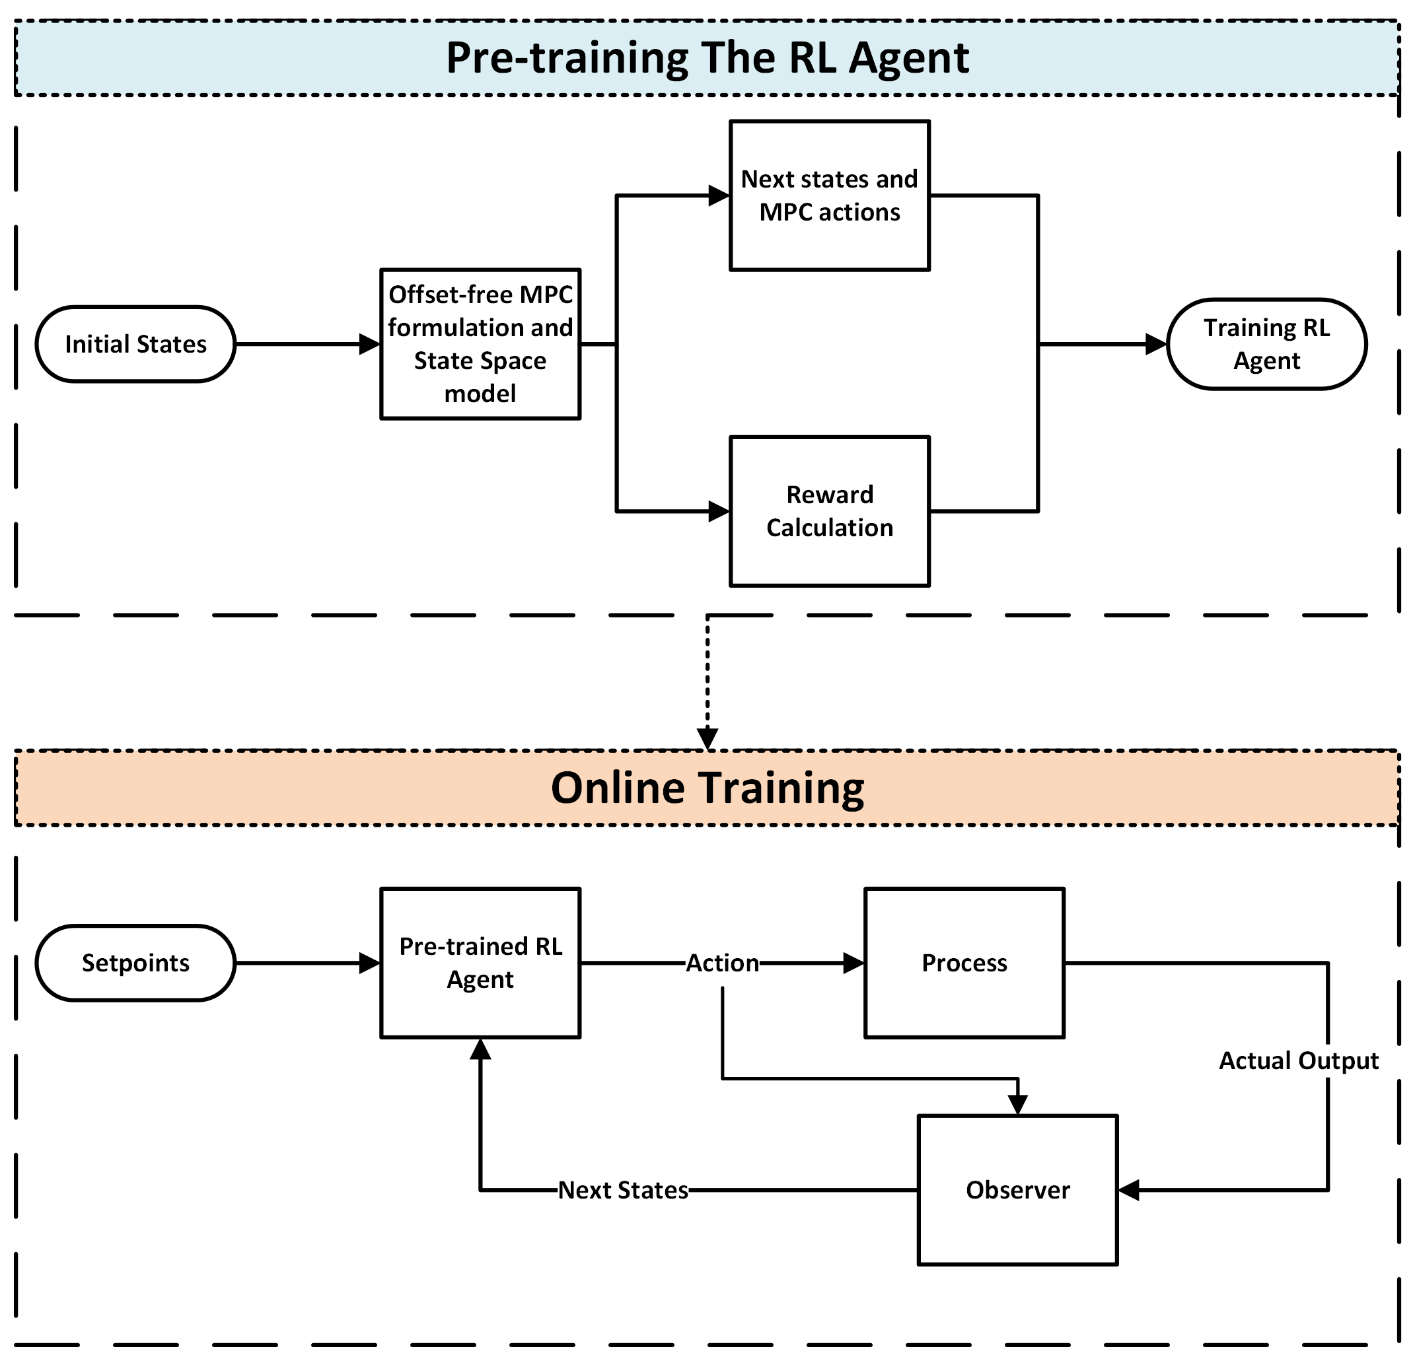
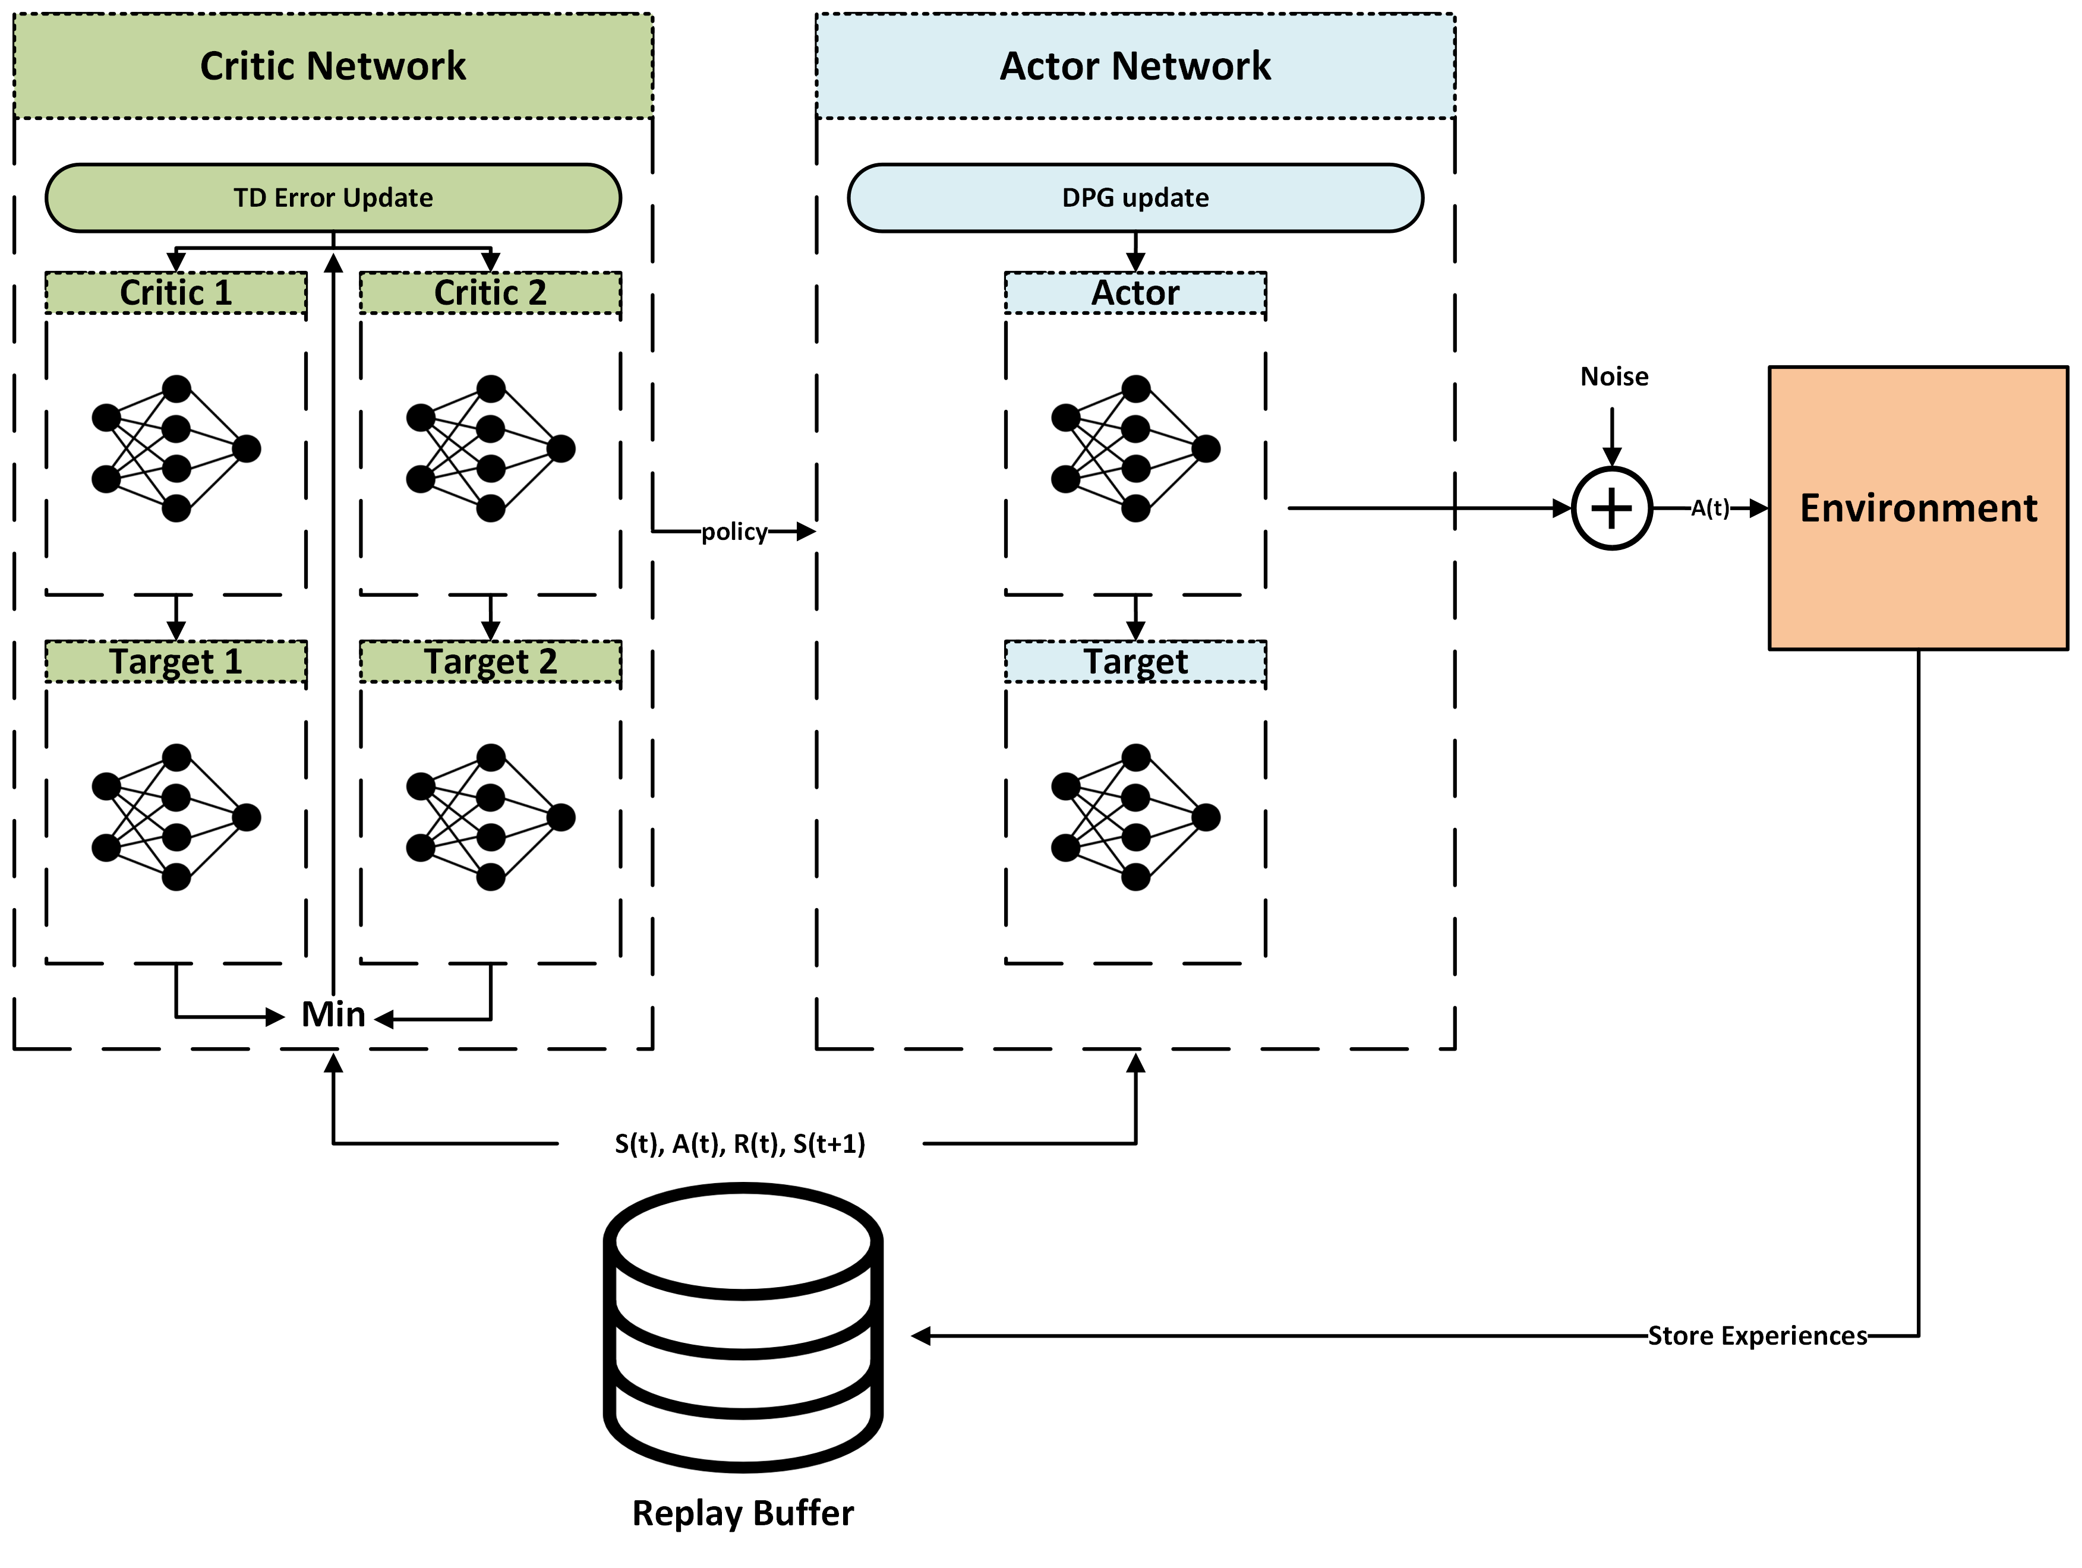
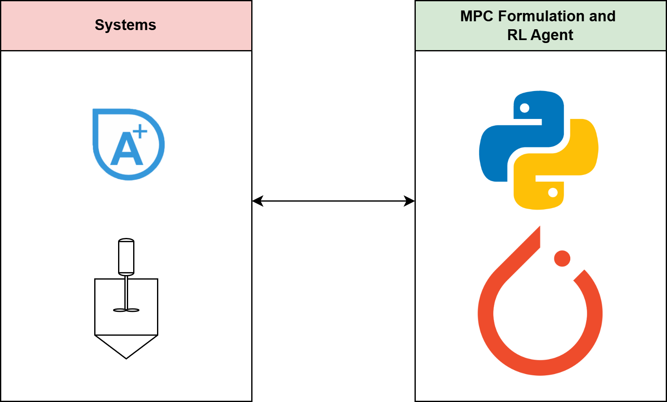
Safe RL Control Implementation
Control Methodology
Block Diagram of RL Controller Design
TD3 Schematic
Working Environment
Pre-train Phase
Linear state-space model from step test
Create random states in range of max and min of the states
Solve MPC formulation and get the control action
Next state and output from the linear state space model
Calculate reward
Stack all these experiences in the replay buffer
Pre-train TD3 Agent
Online deployment Phase
Adjustments to TD3 Agents
  An exponential bonus reward function to encourage offset free behavior
  Huber loss function to learn more from undesired actions
Warm-start: Let the agent with restricted exploration to search over the action boundaries
After warm-start the agent will start training to find the optimal policy
Exploration noise will decay over time
The agent will train under nominal conditions and disturbances
Amir Hossein Hamedi Supervisor: Dr. Mhaskar
MACC Annual Meeting 2025

Slide 4
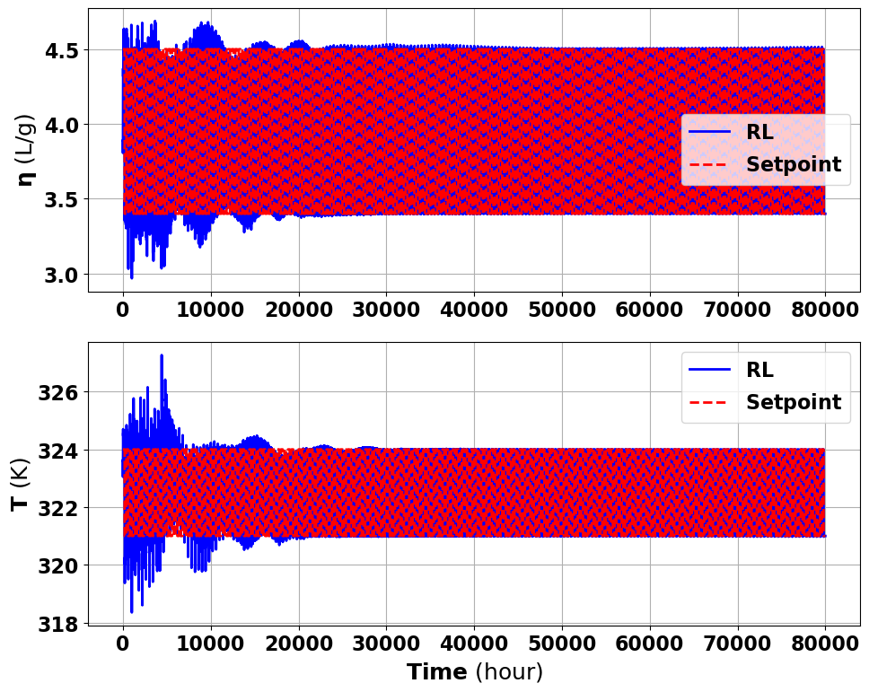
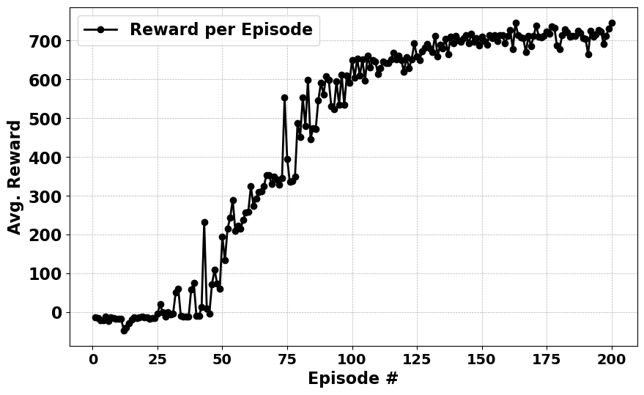
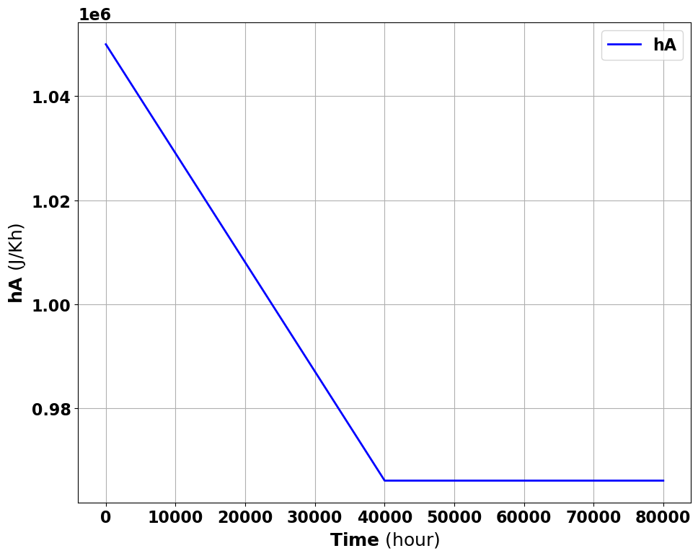
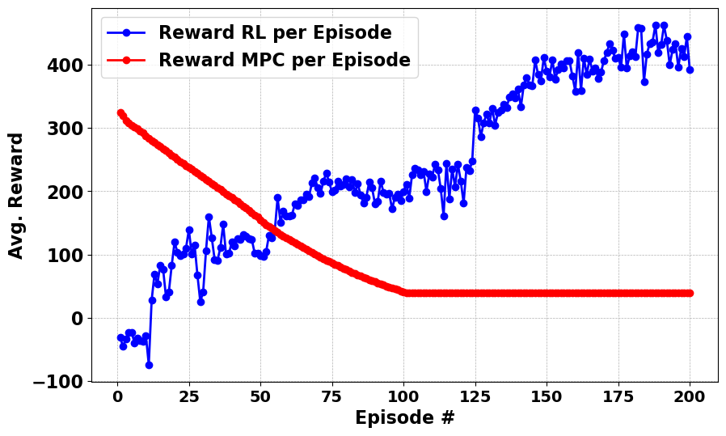
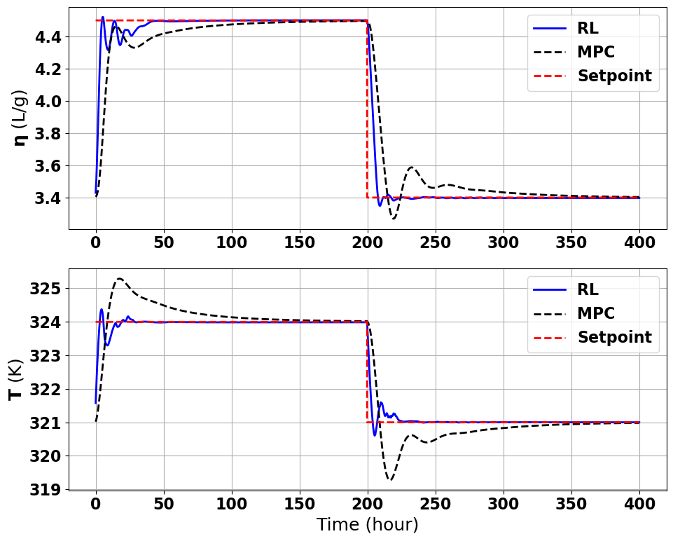
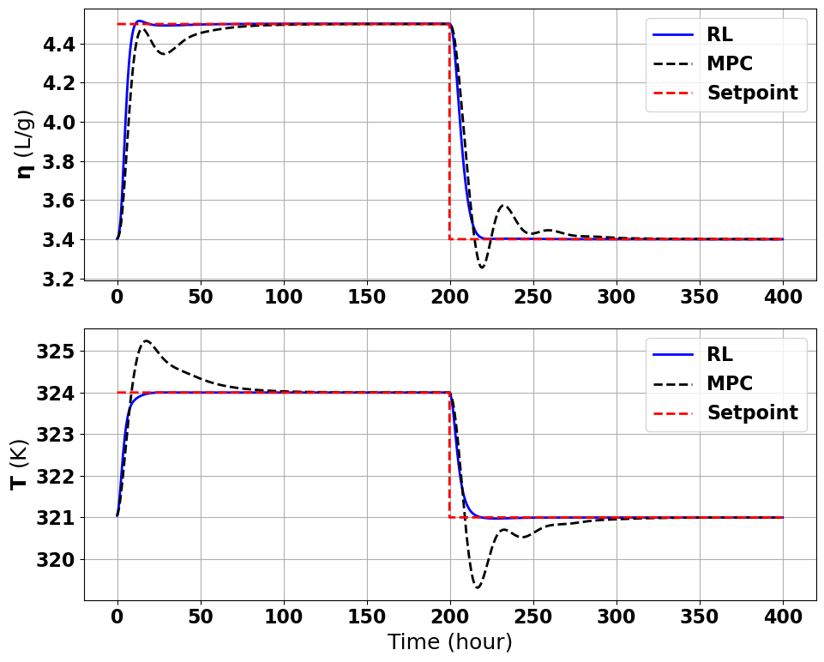
Proposed RL agent controller Results for Polymer Reactor
Results
Nominal Conditions
Under Disturbances
MPC Baseline
a
b
a
b
C
C
a) RL setpoint tracking over 200 episodes b) Average rewards vs. time c) RL vs. MPC for last episode
a) Disturbance b) Average rewards vs. time c) RL vs. MPC for last episode
MACC Annual Meeting 2025

Slide 5
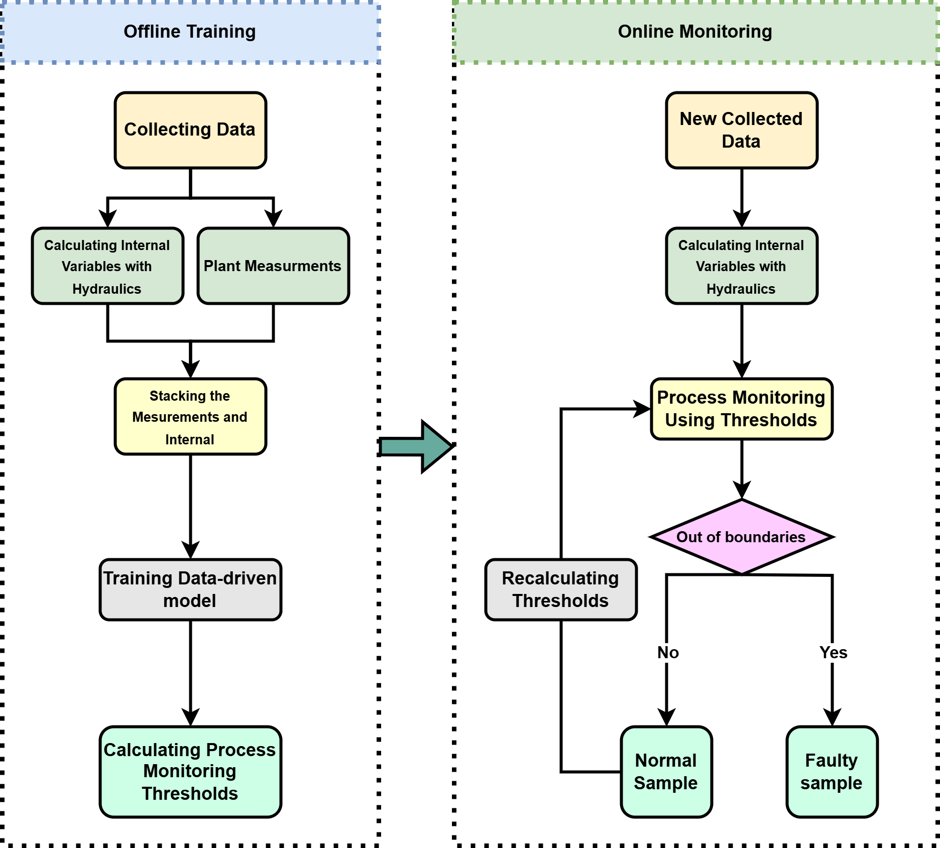
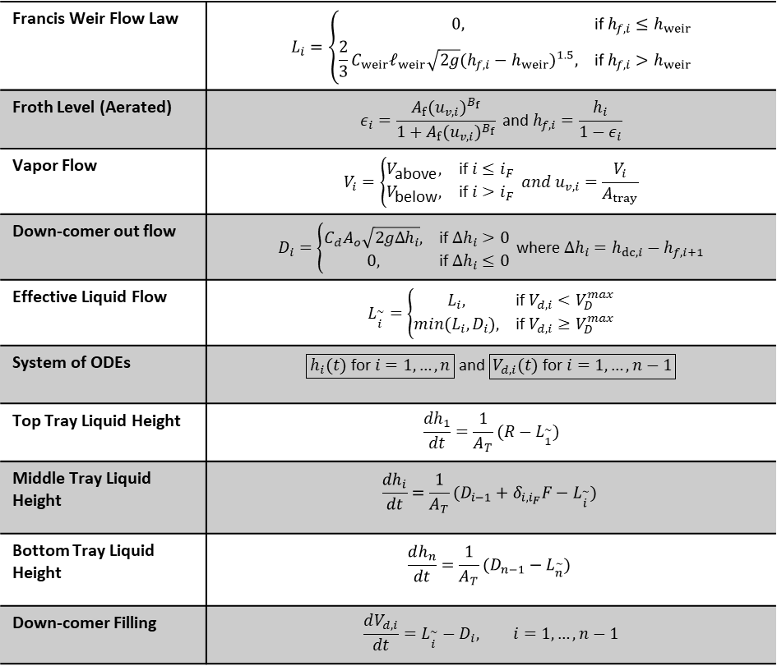
Fault Detection
Hybrid first-principle and data-driven
ODEs Distillation column Hydraulic for first-principle
Proposed Approach
Francis Weir Flow Law | $$L_{i}=\left\{\begin{matrix}0, & \text{if} h_{f,i}≤h_{weir} \\ \frac{2}{3}C_{weir}𝓁_{weir}\sqrt{2g}(h_{f,i}−h_{weir})^{1.5}, & \text{if} h_{f,i}>h_{weir}\end{matrix}\right.$$
Froth Level (Aerated) | $$ε_{i}=\frac{A_{f}(u_{v,i})^{B_{f}}}{1+A_{f}(u_{v,i})^{B_{f}}} \text{and}{ h}_{f,i}=\frac{h_{i}}{1−ε_{i}}$$
Vapor Flow | $$V_{i}=\left\{\begin{matrix}V_{\text{above}}, & \text{if} i≤i_{F} \\ V_{\text{below}}, & \text{if} i>i_{F}\end{matrix}\right. and u_{v,i}=\frac{V_{i}}{A_{tray}}$$
Down-comer out flow | $$D_{i}=\left\{\begin{matrix}C_{d}A_{o}\sqrt{2gΔh_{i}}, & \text{if} Δh_{i}>0 \\ 0, & \text{if} Δh_{i}≤0\end{matrix}\right. \text{where} Δh_{i}=h_{dc,i}−h_{f,i+1}$$
Effective Liquid Flow | $$L_{\overset{\sim }{i}}=\left\{\begin{matrix}L_{i}, & \text{if}{ V}_{d,i}<V_{D}^{max} \\ min(L_{i},D_{i}), & \text{if} V_{d,i}≥V_{D}^{max}\end{matrix}\right.$$
System of ODEs | $$\boxed{h_{i}(t) \text{for} i=1,…,n} \text{and} \boxed{V_{d,i}(t) \text{for} i=1,…,n−1}$$
Top Tray Liquid Height | $$\frac{dh_{1}}{dt}=\frac{1}{A_{T}}(R−L_{\overset{\sim }{1}})$$
Middle Tray Liquid Height | $$\frac{dh_{i}}{dt}=\frac{1}{A_{T}}(D_{i−1}+δ_{i,i_{F}}F−L_{\overset{\sim }{i}})$$
Bottom Tray Liquid Height | $$\frac{dh_{n}}{dt}=\frac{1}{A_{T}}(D_{n−1}−L_{\overset{\sim }{n}})$$
Down-comer Filling | $$\frac{dV_{d,i}}{dt}=L_{\overset{\sim }{i}}−D_{i}, i=1,…,n−1$$
Amir Hossein Hamedi Supervisor: Dr. Mhaskar
MACC Annual Meeting 2025

Slide 6
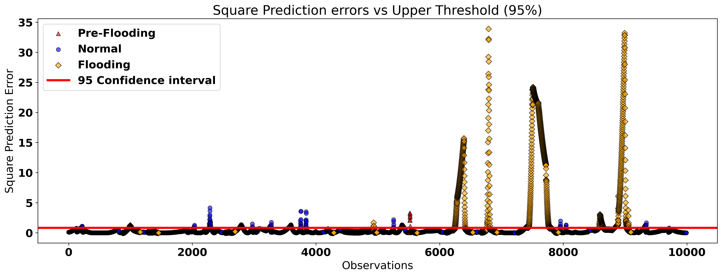
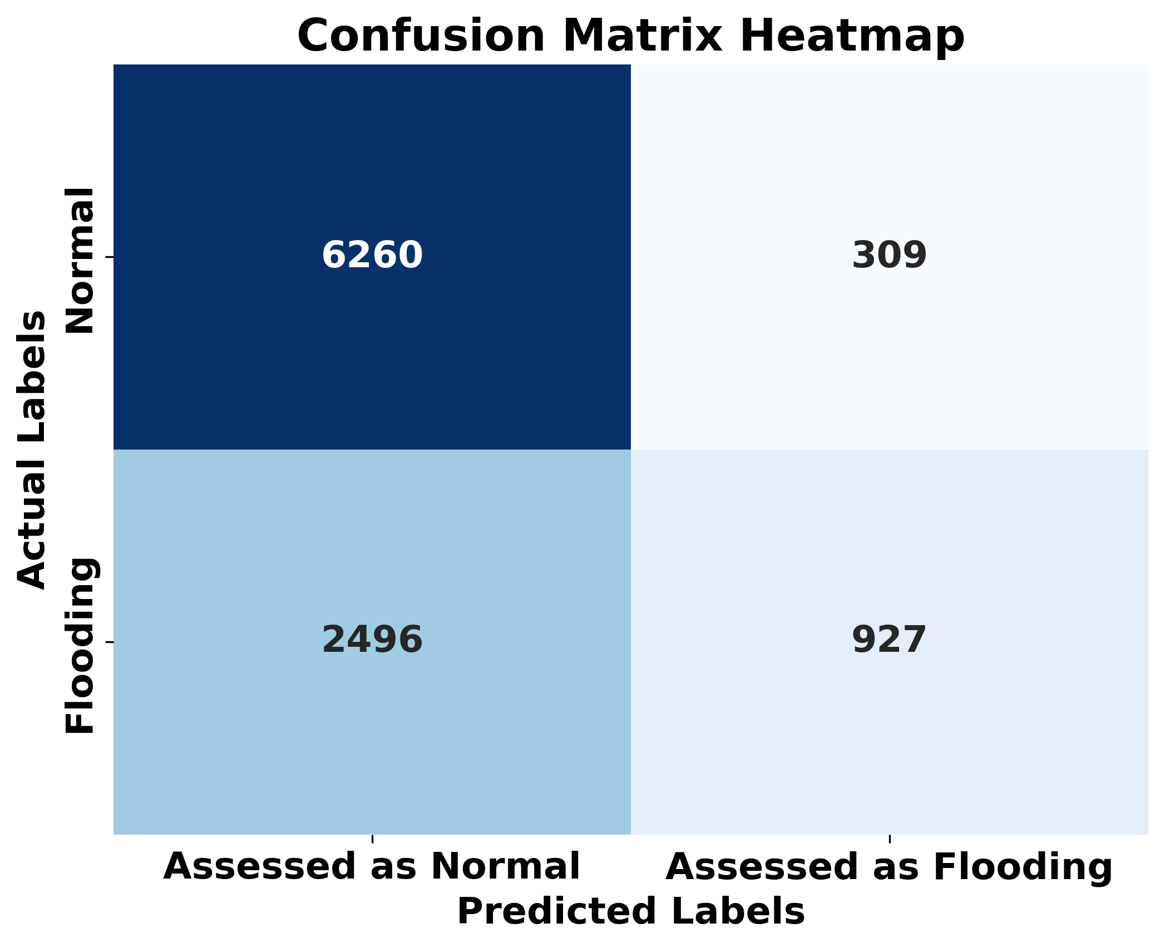
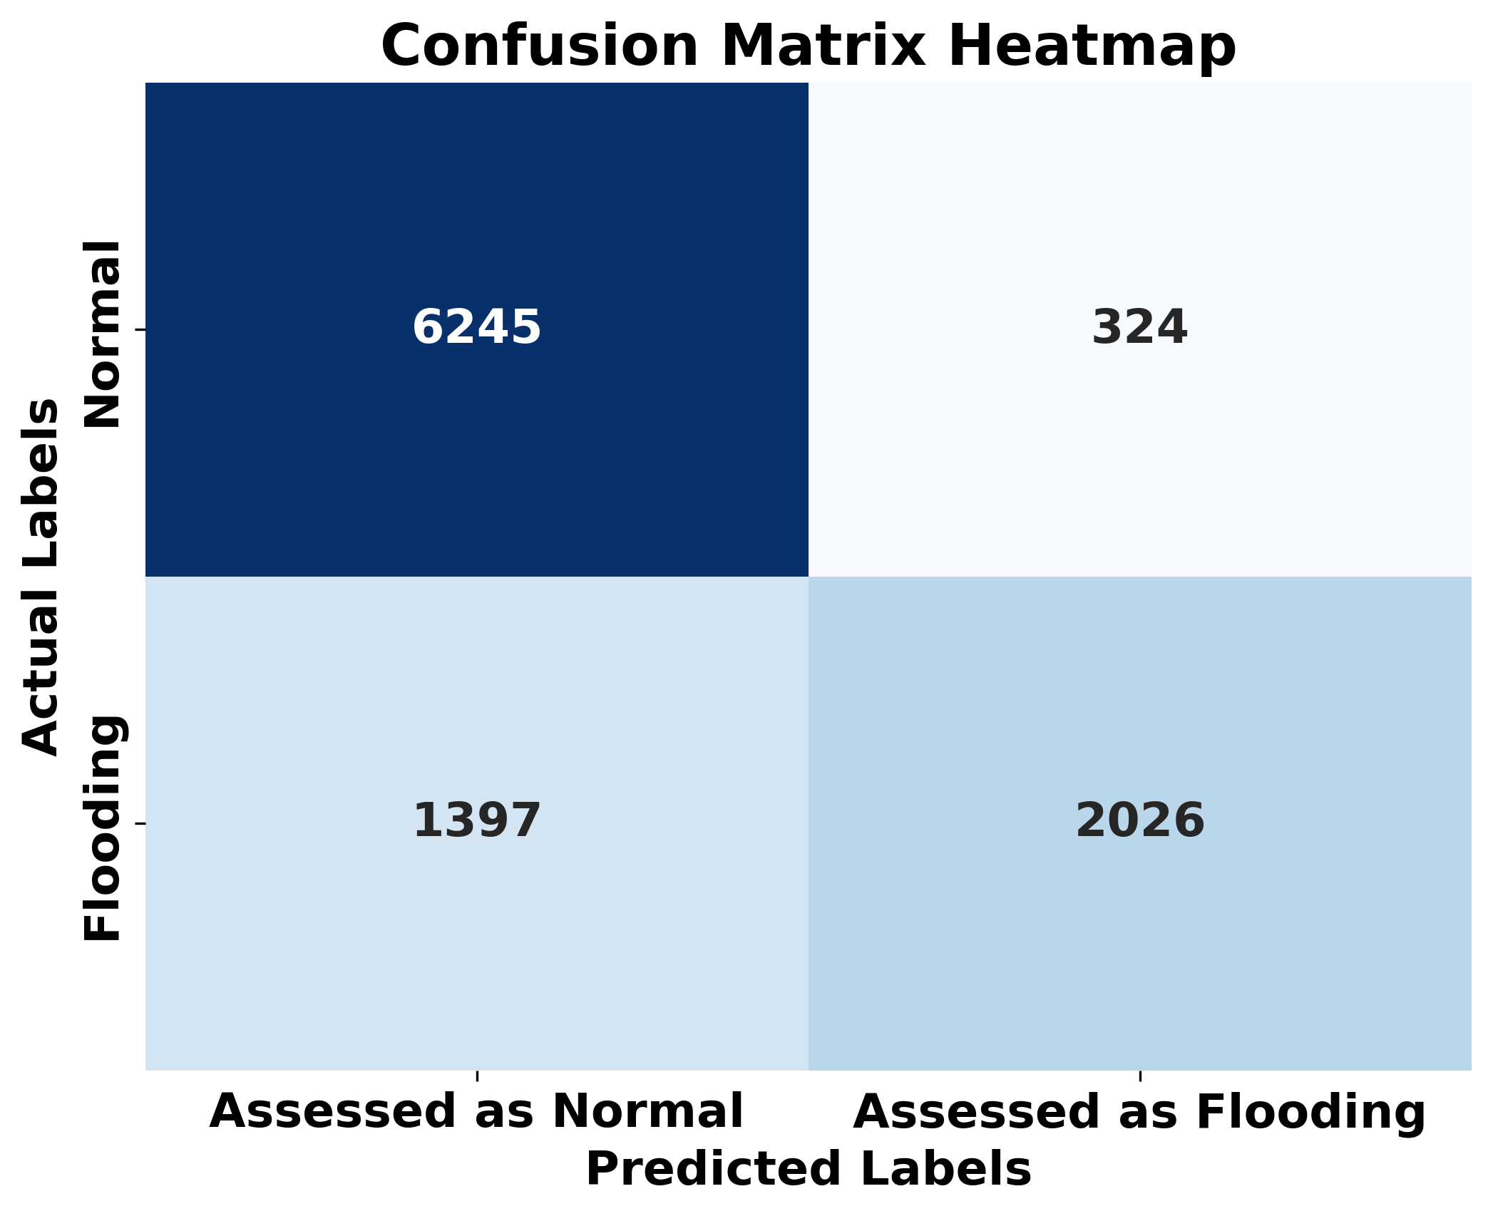
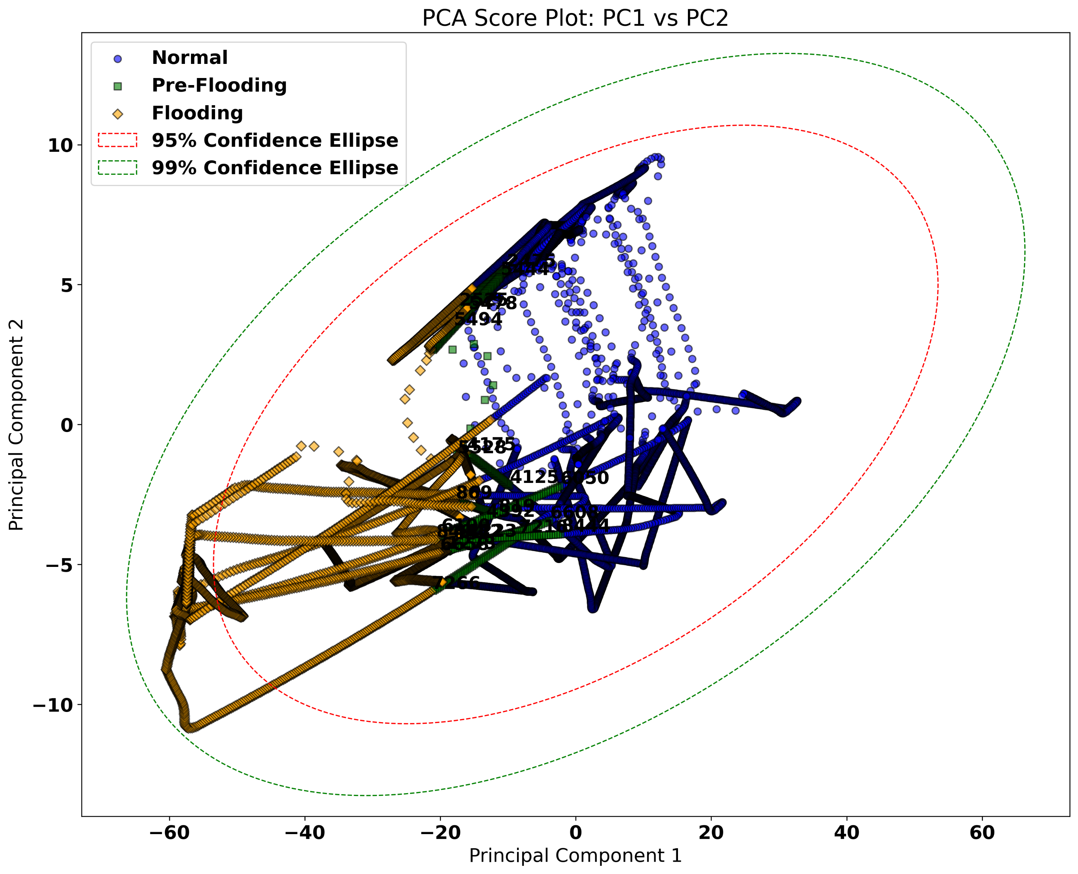

Results and Future Works
Results
Ongoing and Future Works
Ongoing:
RL implementation on the distillation column
Applying soft and hard constraints on the RL controller
Test proposed approach on more disturbances
Adding flash calculation to the hydraulics
Improving predicting capability of the fault detection
Future Works:
Combine Fault detection and RL controller to have an agent that prevent faults
RL-Assisted MPC which improve MPC performance by adjusting MPC and model parameters during the process
RL behavioral cloning and compare to pre-training
a
b
c
a) SPE Chart for Process Monitoring b) Confusion Matrix c) Score Plot (PC1 vs. PC2)
MACC Annual Meeting 2025

